Slide 1
IoT Weather and GIS Visualization Project
Using ESP8266, STM32, and DHT11
Erik Badalyan

Slide 2
Introduction
Project Goals:
- Monitor environmental data using DHT11
- Visualize data on a webpage with GIS mapping
- Use ESP8266 as a web server, STM32 for sensor reading.

Slide 3
Components
1. ESP8266
2. STM32F103
3. DHT11 Sensor

Slide 4
How It Works
1. STM32 reads data from DHT11
2. Data sent to ESP8266
3. ESP8266 hosts webpage with GIS data

Slide 5
Code and Communication
STM32 Code: Reads sensor data
ESP8266 Code: Hosts webpage and displays data

Slide 6
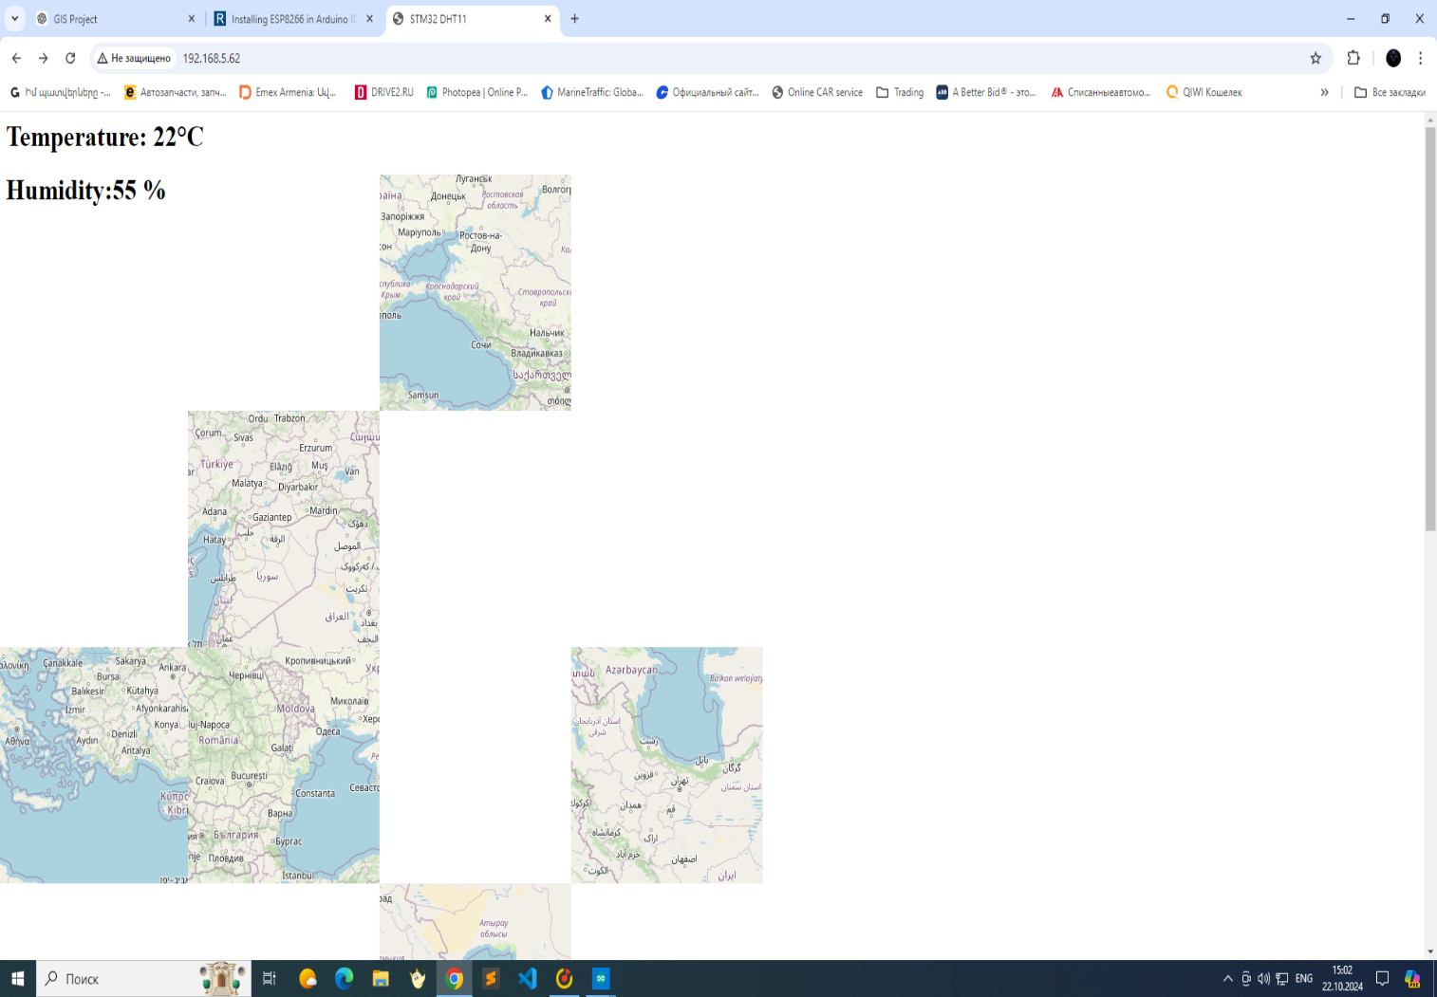
Webpage Visualization
Screenshot of webpage showing live data and GIS map.

Slide 7
Conclusion
Successfully displayed data on a webpage
GIS map for enhanced visualization

Slide 8
Future Enhancements
- Add more sensors
- Cloud integration for remote access
- GPS for real-time location tracking

